Slide 1
Lead Scoring Case Study
Introduction
The company markets its courses on several websites and search engines like Google. Once these people land on the website, they might browse the courses or fill up a form for the course or watch some videos.
When these people fill up a form providing their email address or phone number, they are classified to be a lead.
Moreover, the company also gets leads through past referrals. Once these leads are acquired, employees from the sales team start making calls, writing emails, etc. Through this process, some of the leads get converted while most do not. The typical lead conversion rate at X education is around 30%.
Problem Statement
Lead conversion is low for X Education.
Company wants to identify “Hot Leads” to increase the conversion.
Initial lead generation is good but in the funnelling stage there are many leads which is not converted at the bottom.
Create a model so that customer with high lead score have a higher conversion chance and vice versa.

Slide 2
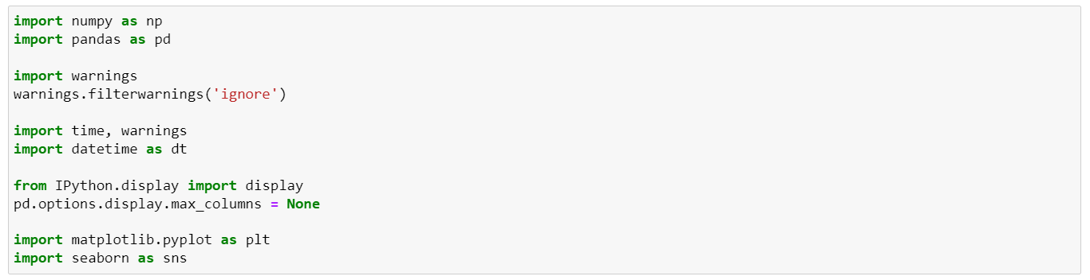
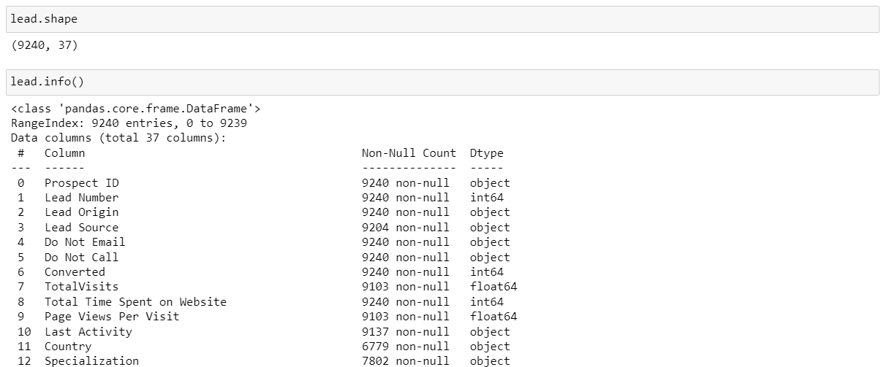
Analysis
Step 1: Import important libraries and warnings
Step 2: Read file and understand data type

Slide 3
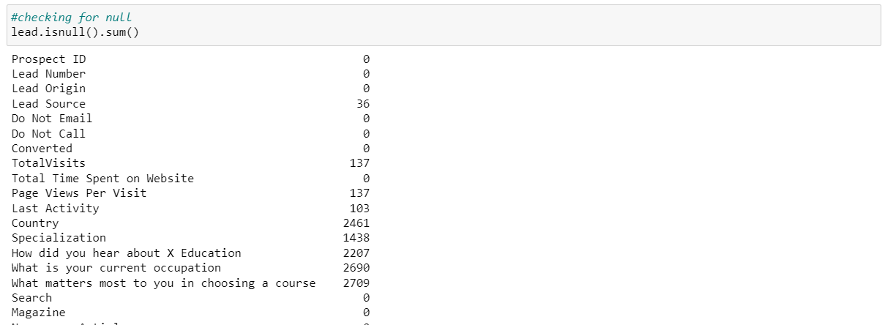
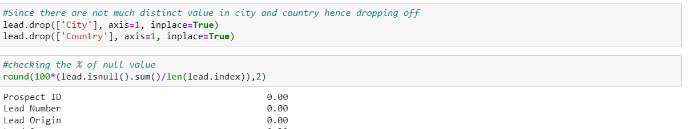
Analysis
Step 3: Check for Null value and remove null values

Slide 4
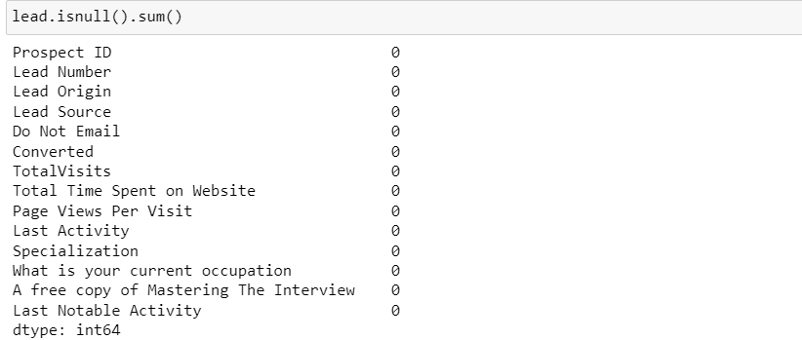
Analysis
Step 4: Variables which were considered for next set of process

Slide 5
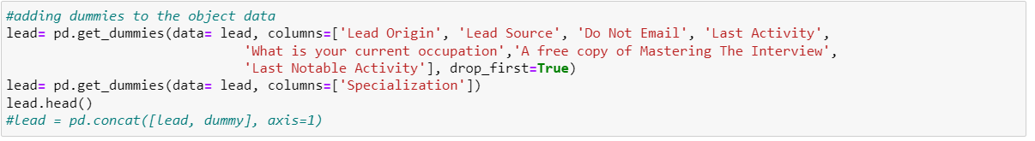
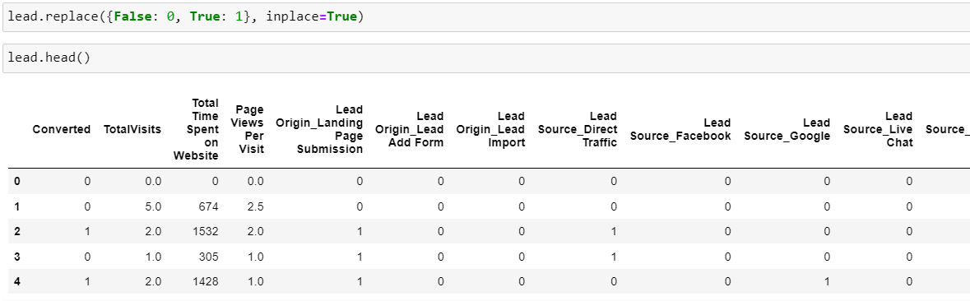
Analysis
Step 5: Prepare data for modelling
Created dummy variable for the object data type

Slide 6
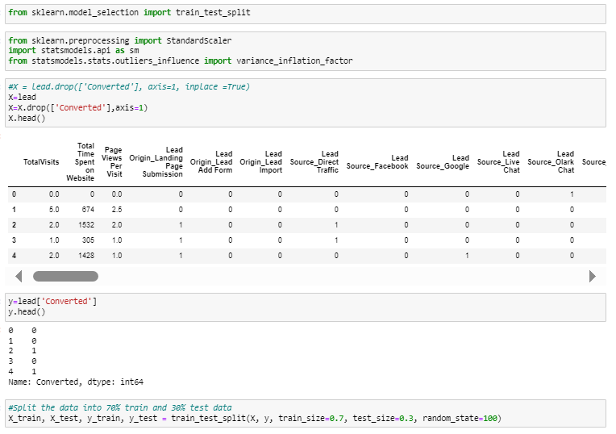
Analysis
Step 6: Train and Split data
Data was split into 70% train and 30% test

Slide 7
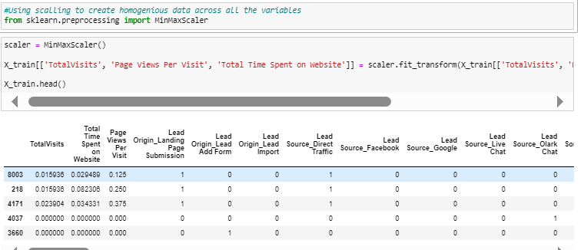
Analysis
Step 7: Scaling the data
Using scaling to create homogeneous data across all the variables

Slide 8
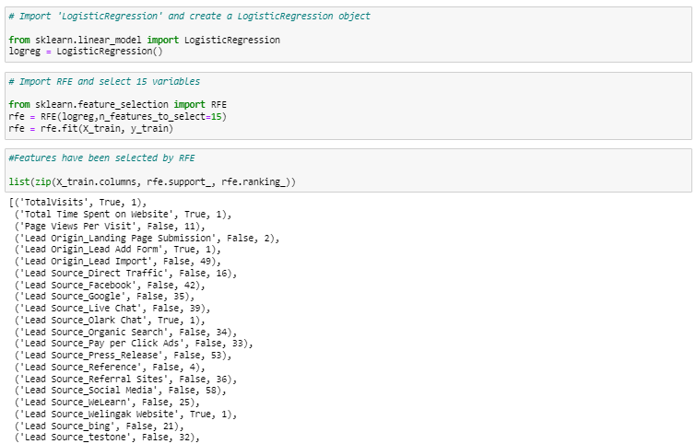
Analysis
Step 8: Model Building
Used RFE to identify variable required to create the model

Slide 9
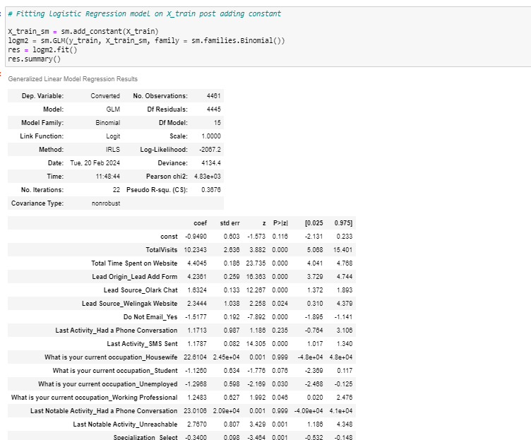
Analysis
Step 9: Fitting logistic regression on the train data set
Used RFE to identify variable required to create the model

Slide 10
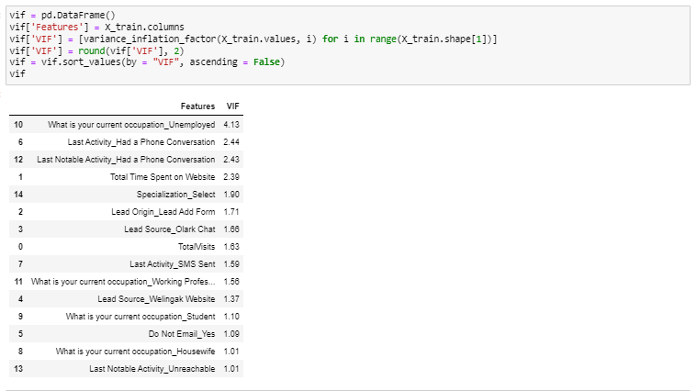
Analysis
Step 10: Checking VIF
Checking Variation inflation factor to manually remove any variable where VIF is >5
Since VIF for the all the variable was within 5 hence it good to go and now our focus is on p value >0.05

Slide 11
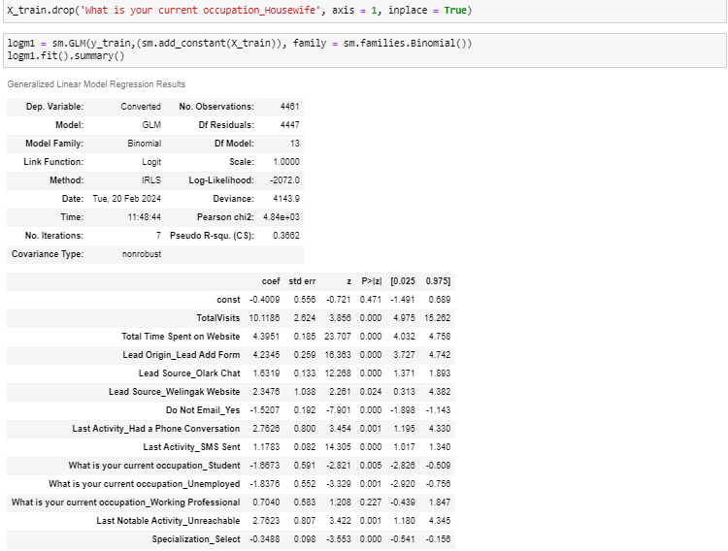
Analysis
Step 11: Checking p-value
For all the variable where p-value is greater than 0.05 remove it
Removed variables- 'What is your current occupation_Working Professional, What is your current occupation_Housewife’

Slide 12
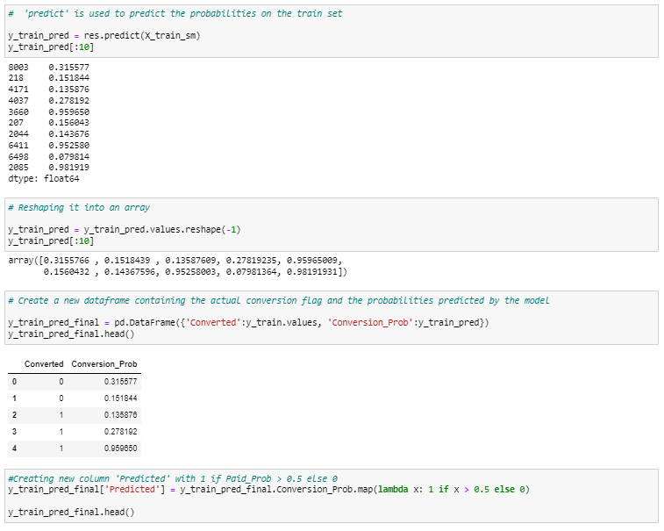
Analysis
Step 12: Model Evaluation

Slide 13
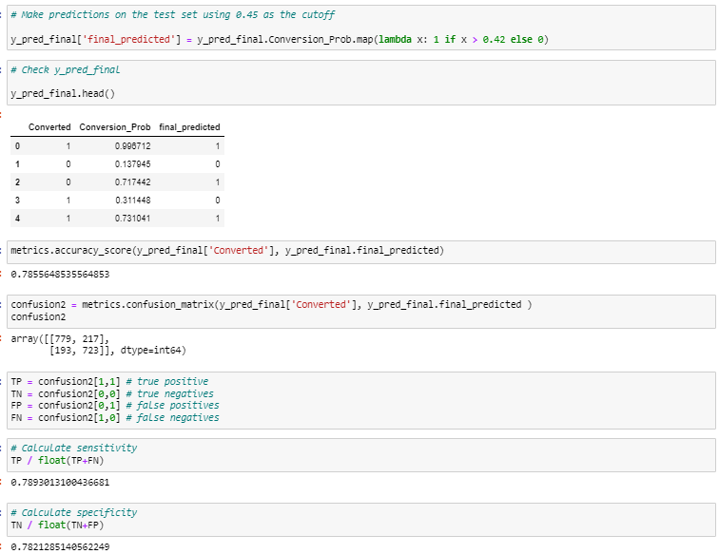
Analysis
Step 12: Model Evaluation
Sensitivity = 79%, Specificity -78% , Accuracy = 79% - hence this model is good to go

